Slide 1
Why Chicago Needs Just Cause for Eviction
Prepared by:
justcausechicago.org
Chicagohousingjusticeleague.org

Slide 2
The Importance of Housing Stability
Chicago has approx. 600,000 rentals, housing about 1.4 million, more than half of the population.
In 40% of Chicago wards, more than 50% of all dwellings are rentals. In 20% of wards, it’s over 60%.
Average of 24,000 eviction court cases filed in Chicago every year.
Top 10 community areas with the highest eviction rates (2010-2019) are all majority African-American communities, with many Latinx communities dealing with “invisible evictions” that aren’t always registered in official statistics
An estimated 20-25% of eviction filings are no-fault, where the tenant has done nothing wrong.
No-fault eviction cases (including non-renewals and terminations) displace about 6,000 families per year. The number increases to over 10,000 considering families who move before an eviction can be filed. Many become homeless, live doubled-up, and are forced to abandon their household goods & possessions.

Slide 3
The Importance of Housing Stability (cont.)
Any disruptions to housing can result in further destabilization to other aspects of life: days missed at work, leading to loss of employment; disruption to a child’s education, including being forced to switch to an unfamiliar school mid-year
At the larger level, housing is the center-piece of a healthy community with good public transportation, good public schools, jobs with meaningful wages, a healthy food system, the arts, and public spaces and parks.
At the personal level, housing is the platform from which springs meaningful life activities: friends, community, worship, schools, a sense of place and belonging in the world.
Just Cause is a matter of racial justice, health justice, & neighborhood stability.

Slide 4
Substitute Just Cause Bill: Basic concepts
Under current law, landlords are not required to give a reason for termination or non-renewal. Notice is given that the relationship is over. A court eviction case is filed if the tenant does not move within the time provided in the notice.
Just Cause ends the practice of ending the landlord-tenant relationship through termination, non-renewal, and eviction without good cause or fault on the tenant’s part.
Why do non-fault displacements occur?
Displacement by gentrification, flipping, masking unlawful retaliation (e.g., against renters requesting repairs or calling 311 about building conditions), masking unlawful discrimination (whether because of race, gender, sexual identity, disability, legal status, etc.).
Just Cause reinforces good management practices and builds more stable landlord-tenant relations.
Already in place in over 10 million rental units nationwide, including over 30,000 units in Chicago. From this vast experience, we know that Just Cause does no harm to landlords, large or small.

Slide 5
Good or Just Causes to Terminate, Non-Renew, Evict
Just Cause would establish 7 exclusive reasons for ending the landlord-tenant relationship: 3 tenant-fault and 4 non-tenant fault:
3 tenant-fault cover all of the existing reasons: non-payment of rent, material breach of the lease or law (e.g., disrupting neighbors, damaging property, criminal activity, denying the landlord access, drug-related activity), or refusing to renew the lease on similar terms.
4 non-tenant fault reasons widely considered legitimate: landlord wishes to occupy the unit or have a close family member do so, the unit needs substantial repair/rehab, condominium conversion, and demolition or removing the unit from the market.

Slide 6
Payment of Relocation Assistance
4 non-tenant-fault reasons for removal, landlord pays relocation assistance:
Generally, 5x the city median by bedroom size; OR
For small landlords (owner-occupied buildings of 6 or fewer units), 3x the city median by bedroom size; OR
For non-profit, mission driven owners, established based on existing federal/state/local standards, or 3x city median by bedroom size; AND
A flat $2500 if there is a school-aged child, or a senior, or disabled person in the tenant's household (non-stackable).
For small landlords (owner-occupied, 6 or fewer units):
Pay less than the general standard.
Establishes a fund through a rental registry where the city can reimburse 50% of the relocation assistance paid to tenants, and 100% if moving in a family member.
Flexibility for landlord and tenant to agree on how relocation will be paid (e.g., rent reduction, abatement, etc.). Increases convenience for small landlords.

Slide 7
Rental Registry
The bill creates a rental registry to help better understand the city’s 600,000 rental units, helps city departments clarify ownership and management, and creates a fund to partially reimburse small landlords for relocation paid in cases of no-fault end of landlord-tenant relationship.
Annual per unit registration fees: larger landlords $100. No fees for owner-occupied, 6 or fewer unit owners, and nonprofit owners. Generates ~$40 million per year. CHA owned properties are also exempt from the fee.
Allocation of registration: payment of relocation assistance reimbursement for small landlords, administration of registry, and other housing-related programs, including Healthy Homes Inspections.

Slide 8
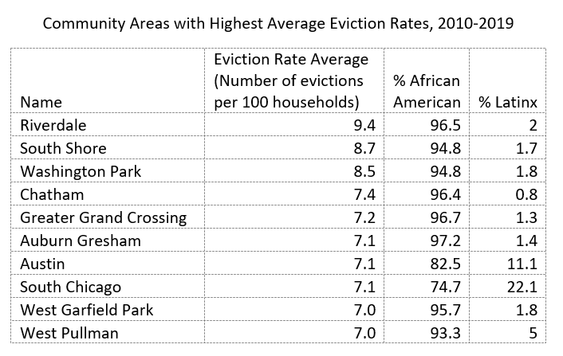
Evictions are a racial justice issue, and destabilize African American neighborhoods
Evictions are already about to overwhelm the city. Why not prevent as many as possible with the tools we have in front of us?
Evictions do not land evenly across the board -- they hit Black and Latinx areas especialy hard, and have led to the outmigration of African-Americans from Chicago over the last few decades, and the gentrification of Latinx areas
Source: LCBH Eviction Data Portal

Slide 9
List of Jurisdictions With Some Form of Just Cause
Federal
All conventional public housing units nationwide, including those in Chicago
All privately owned units receiving “project-based” rental assistance nationwide, including those in Chicago
All privately owned units receiving assisted through the federal tax credit program, including those in Chicago
State
Washington (2021)
California (2019)
Oregon (2019)
New Hampshire (1985)
New Jersey (1974)
City
18 California cities have enacted local laws, including: Berkley, East Palo Alto, Glendale, Hayward, Los Angeles, Maywood, Mountain View, Oakland, Richmond, San Diego, San Francisco, San Jose, West Hollywood
Albany, NY
Burien, WA
Federal Way, WA
New York, NY (rent-stabilized units)
Philadelphia, PA
Portland, OR
St. Paul, MN
Seattle, WA
Washington, D.C.
In total, Just Cause is in effect at more than 10 million units nationwide.

Slide 10
Right to Cure Non-Payment of Rent
Bill extends existing Right to Cure (RtC) non-payment of rent
Previously, tenant could pay back-rent within five days of receiving an eviction notice. Fair Notice, passed summer 2020, extended it to the day the court issues an eviction order, but only allows tenants to cure one time per landlord, and exempts small landlords.
Just Cause bill expands RtC to small landlords and removes the one-time cap.
Q: Will landlords face ongoing uncertainty of getting rent? A: No, there are deterents to renters using the extended RtC except in extraordinary circumstances. Curing non-payment costs $500-$600 in court fees on top of all back-rent, and the mere filing of an eviction court case damages the renter’s credit report and score (regardless of the grounds or outcome).

Slide 11
Graduated Notice for Rent Increases
For any single or cumulative rent increase, during any consecutive 12-month period, notice must be given:
30 days for increases less than 5%
60 days for increases of 5% but less than 10%
90 days for increases of 10% but less than 15%
120 days for increases of 15% or more
For increases of 20% or greater, tenant has option to move & take relocation assistance.
Increases of 50% or greater deemed excessive and unconscionable (e.g., increase from $1500 to $2250 in a 12-month period).

Slide 12
The Public Health Case for Passing the Just Cause for Eviction Ordinance
Prepared by Health & Medicine Policy Research Group,
member of the Chicago Housing Justice League
Contact: Wesley Epplin, MPH, Policy Director wepplin@hmprg.org

Slide 13
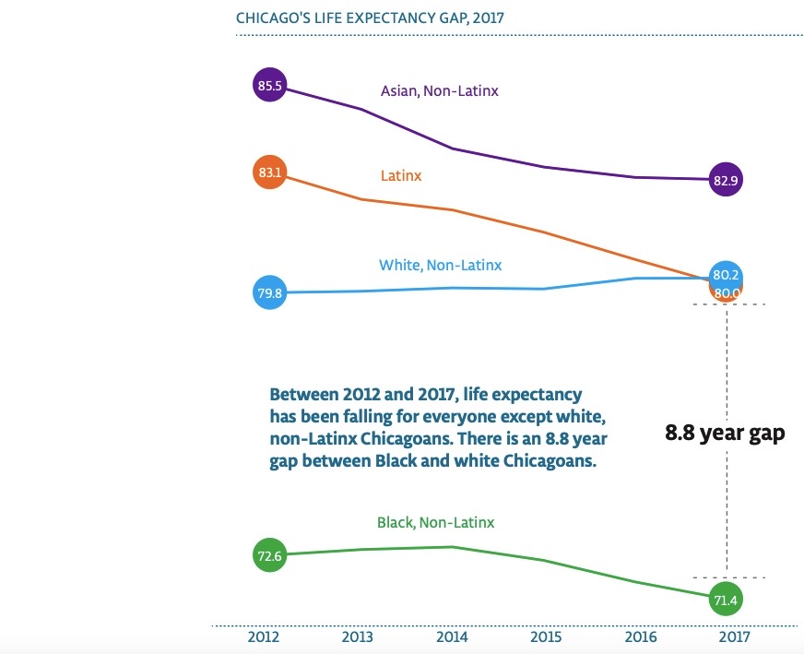
Health inequity shown in a chart: Chicago’s Life Expectancy Gap
Chicago has severe health inequities.
Inequitable policy is a structural cause of health inequities.
Chart from Healthy Chicago 2025, published by Chicago Department of Public Health (2020): https://www.chicago.gov/content/dam/city/depts/cdph/statistics_and_reports/HC2025_917_FINAL.pdf

Slide 14
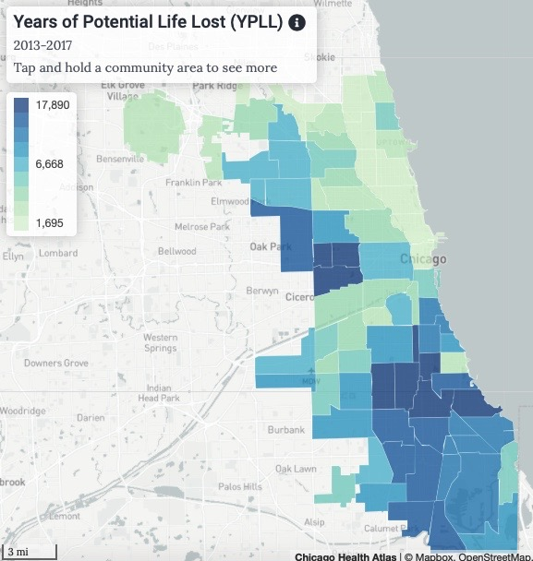
Health inequity shown on a map: Years of Potential Life Lost (YPLL) per 100,000 population, by community area
The Just Cause for Eviction Ordinance will advance equitable housing and protect public health
Chart from the Chicago Health Atlas: https://chicagohealthatlas.org/indicators/YPLL?topic=years-of-potential-life-lost-ypll

Slide 15
Public Health Harms of Evictions
Evictions can cause:
Stress and associated mental health problems, such as anxiety and depression
Stress can contribute to high blood pressure, cardiovascular disease, and obesity
Increased likelihood of multiple moves and reduced quality housing
Low quality housing can be hazardous to health by exacerbating asthma or causing lead poisoning, among other health problems
Homelessness and the associated health harms and risks
Lost belongings and major cost of moving and replacing items
Economic stability is critical to individuals’ and families’ health
Disrupted ability to travel to workplaces and participate in work, contributing to job destabilization and job loss
Job loss contributes to income loss, with many negative public health effects
List continues on the next slide

Slide 16
Public Health Harms of Evictions (cont’d from prior slide):
Evictions can cause:
Increased maternal depression rates
Negative effects on children’s health and safety, including worse school performance and behavioral problems
Displacement, contributing to our city’s loss of thousands of Black Chicagoans who move away each year
Community destabilization and disrupted community connections
Reduced ability to civically engage and to build social cohesion
Both reflected and worsened structural racism and class inequity, injustices that are fundamental root causes of health inequities

Slide 17
According to Healthy Chicago 2025, the Community Health Improvement Plan published by CDPH:
“Housing stability, affordability, quality and safety all affect health. Poor housing conditions are associated with a wide range of health outcomes including respiratory infections, asthma, lead poisoning, injuries and mental health. In Chicago, one in five adults usually or always worries about having enough money to pay their rent or mortgage. Increasing access to affordable housing is associated with increased household discretionary income, increased health insurance coverage, decreased need for emergency care, decreased personal debt, increased savings for home ownership and educational attainment.”
Healthy Chicago 2025: https://www.chicago.gov/content/dam/city/depts/cdph/statistics_and_reports/HC2025_917_FINAL.pdf

Slide 18
Appendix 1: Eviction, Housing and Racial Demographic Data
Ward | Average Annual Eviction Filing Rate Per 100 Households | Average Annual Evictions, 2010-2019 | Total Rental Units | Total Units | Percent Rental Units | Percent Black | Percent Latinx
1 | 1.92 | 307 | 31399 | 55368 | 56.7% | 5.3% | 31.4%
2 | 2.45 | 441 | 44030 | 84121 | 52.3% | 6.7% | 9.6%
3 | 6.37 | 964 | 25159 | 44157 | 57.0% | 59.7% | 3.6%
4 | 6.8 | 1317 | 41638 | 66330 | 62.8% | 55.5% | 4.8%
5 | 6.11 | 1221 | 34273 | 51395 | 66.7% | 61.2% | 5.2%
6 | 5.86 | 920 | 21512 | 40699 | 52.9% | 95.3% | 2.1%
7 | 7.99 | 1234 | 21719 | 41281 | 52.6% | 89.4% | 6.7%
8 | 6.86 | 873 | 20355 | 41341 | 49.2% | 96.2% | 1.1%
9 | 6.35 | 587 | 17135 | 39917 | 42.9% | 92.0% | 4.4%
10 | 4.16 | 287 | 12538 | 29538 | 42.4% | 19.4% | 64.3%
11 | 2.57 | 274 | 20548 | 37238 | 55.2% | 5.8% | 21.2%
12 | 3.16 | 265 | 17049 | 32020 | 53.2% | 3.3% | 76.4%
13 | 3.85 | 147 | 8390 | 30147 | 27.8% | 2.3% | 70.0%
14 | 3.13 | 170 | 13251 | 32844 | 40.3% | 1.1% | 82.1%
15 | 3.9 | 327 | 14984 | 28167 | 53.2% | 16.6% | 74.5%
16 | 6.08 | 631 | 19018 | 36092 | 52.7% | 57.7% | 39.3%
17 | 7.35 | 818 | 19303 | 38977 | 49.5% | 78.9% | 16.7%
18 | 5.38 | 180 | 6874 | 29097 | 23.6% | 52.1% | 36.7%
19 | 5.11 | 180 | 7910 | 36659 | 21.6% | 26.0% | 6.9%
20 | 6.15 | 913 | 25884 | 40114 | 64.5% | 75.2% | 15.2%
21 | 7.16 | 637 | 12605 | 30670 | 41.1% | 96.9% | 1.0%
22 | 2.55 | 188 | 11391 | 24294 | 46.9% | 6.1% | 88.1%
23 | 3.98 | 176 | 14282 | 43075 | 33.2% | 1.5% | 71.6%
24 | 5.6 | 631 | 21234 | 34004 | 62.4% | 80.5% | 14.5%
25 | 2.78 | 357 | 26469 | 46218 | 57.3% | 8.9% | 48.3%

Slide 19
Ward | Average Annual Eviction Filing Rate Per 100 Households | Average Annual Evictions, 2010-2019 | Total Rental Units | Total Units | Percent Rental Units | Percent Black | Percent Latinx
25 | 2.78 | 357 | 26469 | 46218 | 57.3% | 8.9% | 48.3%
26 | 3.72 | 470 | 22728 | 36991 | 61.4% | 11.1% | 58.9%
27 | 6.32 | 965 | 43046 | 74731 | 57.6% | 45.7% | 14.3%
28 | 5.44 | 841 | 32041 | 50844 | 63.0% | 72.6% | 6.9%
29 | 6.04 | 714 | 23490 | 51619 | 45.5% | 64.9% | 18.5%
30 | 2.78 | 259 | 19400 | 41205 | 47.1% | 2.1% | 67.6%
31 | 3.47 | 320 | 18584 | 36061 | 51.5% | 2.2% | 76.0%
32 | 1.41 | 184 | 24440 | 49768 | 49.1% | 3.2% | 16.0%
33 | 1.99 | 231 | 20034 | 36861 | 54.4% | 4.1% | 45.9%
34 | 6.52 | 359 | 10665 | 33804 | 31.5% | 94.5% | 1.5%
35 | 2.2 | 256 | 26275 | 45648 | 57.6% | 3.8% | 62.0%
36 | 3.05 | 216 | 12046 | 33010 | 36.5% | 2.8% | 70.3%
37 | 7 | 718 | 16947 | 30212 | 56.1% | 67.1% | 29.3%
38 | 2.34 | 137 | 12641 | 44324 | 28.5% | 1.9% | 28.1%
39 | 2 | 178 | 15187 | 38161 | 39.8% | 2.6% | 23.6%
40 | 2.3 | 311 | 27260 | 45584 | 59.8% | 7.5% | 21.9%
41 | 2.77 | 173 | 13572 | 47575 | 28.5% | 1.4% | 11.2%
42 | 4.13 | 731 | 40869 | 76906 | 53.1% | 4.0% | 6.2%
43 | 1.39 | 237 | 25908 | 48990 | 52.9% | 4.1% | 5.0%
44 | 1.27 | 293 | 31027 | 50460 | 61.5% | 2.7% | 6.6%
45 | 2.77 | 244 | 14409 | 40503 | 35.6% | 1.3% | 27.7%
46 | 2.84 | 589 | 29157 | 45680 | 63.8% | 17.2% | 13.3%
47 | 0.98 | 164 | 27838 | 51405 | 54.2% | 2.2% | 12.6%
48 | 3.24 | 663 | 29553 | 46051 | 64.2% | 15.1% | 13.7%
49 | 3.92 | 723 | 25125 | 37308 | 67.3% | 26.8% | 19.9%
50 | 3.99 | 369 | 17193 | 34268 | 50.2% | 12.9% | 17.2%

Slide 20
Appendix 2: List of Community Endorsers
A Just Harvest Access Living Action Now Institute ​AIDS Foundation of Chicago Asian Americans Advancing Justice Chicago Autonomous Tenants Union Brighton Park Neighborhood Council Center for Neighborhood Technology Center for Popular Democracy Centro Autonomo Chicago Area Fair Housing Alliance Chicago Area Peace Action Chicago Coalition for the Homeless Chicago Democratic Socialists of America Chicago Homelessness and Health Response Group for Equity (CHHRGE) | Chicago Lawyers Committee for Civil Rights Under Law Chicago Teachers Union Chicago Urban League Collaborative for Health Equity Cook County Communities United Enlace Enterprise Community Partners Equiticity 48th Ward Neighbors for Justice IPO ​Garfield Park Community Council Grassroots Collaborative Harold Washington Vets Post 1987 & Auxiliary Health & Medicine Policy Research Group Healthy Illinois HOME: Housing Opportunity & Maintenance for the Elderly Housing Action Illinois | Housing Choice Partners Howard Brown Health Illinois Public Health Institute Jane Addams Senior Caucus Kenwood Oakland Community Organization Latino Policy Forum Lawyers' Committee for Better Housing Legal Aid Society of Metro. Family Services Lugenia Burns Hope Center Metropolitan Planning Council Metropolitan Tenants Organization ​NAMI Chicago Northside Action for Justice Northside Community Resources Northwest Side Housing Center ONE Northside People's Action | People for Community Recovery Pilsen Alliance PolicyLink ​Rooted REPS SEIU Healthcare IL/IN Shriver Center for Poverty Law SOMOS Logan Square Supportive Housing Providers Association 25th Ward IPO Unete: Little Village Community Devel. Comm. United Neighbors of the Thirty-Fifth Ward (UN35) ​United Working Families Uptown People's Law Center Westside Health Authority Women's March Illinois Working Family Solidarity

